Slide 1
The 7th (and hopefully, the last) tutorial to Docker (and some Kubernetes)
oof

Slide 2
So..what’s Docker?
Textbook definition:
Docker is a tool designed to make it easier to create, deploy, and run applications by using containers. Containers allow a developer to package up an application with all of the parts it needs, such as libraries and other dependencies, and ship it all out as one package.

Slide 3
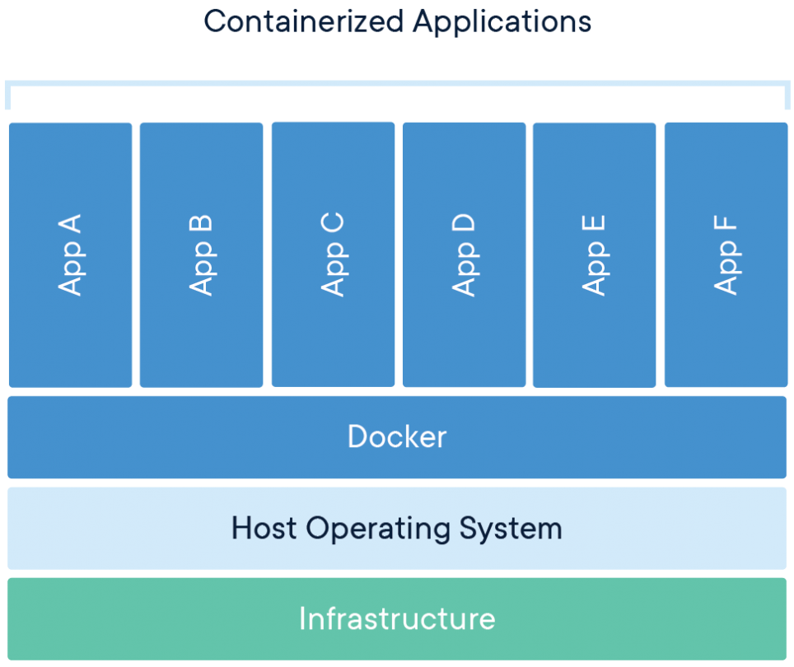
Every Docker presentation MUST have this image

Slide 4
..go ahead and ask the other classical question
“What’s the difference between running an docker image vs running a virtual machine”

Slide 5
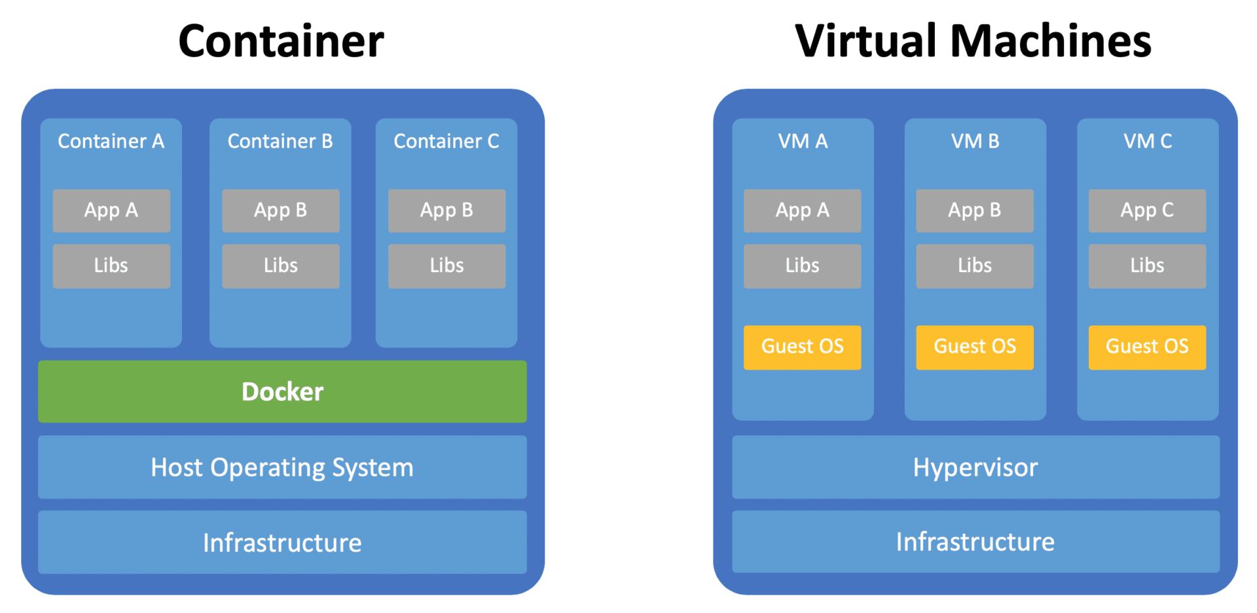
Every Docker presentation MUST have this image as well!

Slide 6
Containers?
Textbook definition:
A container is a standard unit of software that packages up code and all its dependencies so the application runs quickly and reliably from one computing environment to another.
A Docker container image is a lightweight, standalone, executable package of software that includes everything needed to run an application: code, runtime, system tools, system libraries and settings.

Slide 7
Trivial Example – Using someone else’s container images
Let’s fire up a WordPress instance. Let’s start from the basics and improve bit by bit
Most basic –
sudo docker run --name wordpress -d wordpress

Slide 8
Let’s dissect the command
sudo docker run --name wordpress -d wordpress
Sudo – need admin privileges
Docker – the runtime we’re using to spin up container instances
Run – runs an image as a container instance
--name – set a custom name to our instance instead of some auto-generated garbage
-d – detatched; run it and disconnect from the console
wordpress – the name of the image we’re looking for

Slide 9
Where is the wordpress image located?
Docker firstly looks locally to see whether the image exists.
If it doesn’t, it goes to look for the image on DockerHub.
https://hub.docker.com/
You can add your own hubs to look for images (we’ll do this step later)

Slide 10
Demo time!

Slide 11
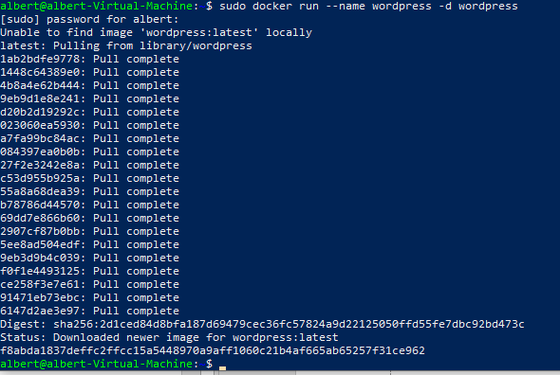
Let’s dissect the output

Slide 12
Let’s dissect the output
Unable to find image 'wordpress:latest' locally
OK – this image was not found on the machine and Docker had to go to DockerHub to download it.
Hash + “pull complete” - ???
The container has a writeable layer that stacks on top of the image layers. This writeable layer allows you to “make changes” to the container since the lower layers in the image are read-only.

Slide 13
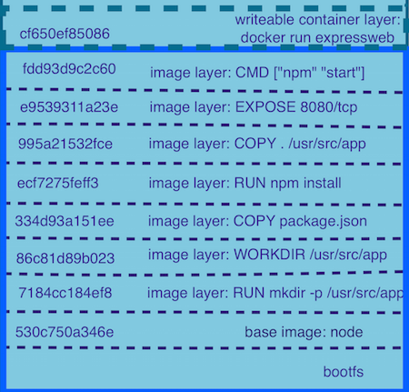
Let’s dissect the output

Slide 14
Manage running containers
Query docker the current list of running containers
docker ps
We can also remove the current container so we’ll move on to the next example
docker containers rm <id> -f
-f to force deletion since its running (not to pay respects)

Slide 15
Let’s try again..but now let’s make it accessible from outside the container
Let’s fire up a WordPress instance. Let’s map port 80 to our port 80
Most basic –
docker run --name wordpress -d -p 80:80 wordpress
We can choose whatever external port we want
docker run --name wordpress -d -p 6969:80 wordpress
We now have two running instances at the same time!

Slide 16
Demo time!

Slide 17
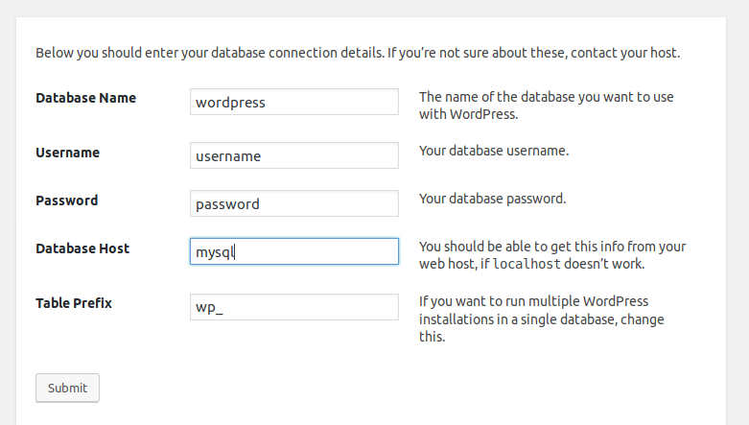
WordPress is running!

Slide 18
Our DB is server missing though..
WordPress without a database is as useful as:
White crayon
An inflatable dartboard
The letter G in lasagna
Referees in a WWE fight
Glass hammer
A bicycle for a fish
Me

Slide 19
Let’s add a database server
Spin up a new container
docker run --name mysql -e MYSQL_ROOT_PASSWORD=albert -d mysql:5.6
We’re using mysql:5.7 for compatibility reasons – the current WordPress image isn’t compatible with the latest mysql image
New parameter
-e MYSQL_ROOT_PASSWORD – obviously custom to this image
Sets an environment variable scoped to this container only
Good (and mostly standard) way to pass config values from installation to instance

Slide 20
Sanity checks on MySQL Server
We can connect to the container and execute commands on it
sudo docker exec -it mysql mysql -uroot -p
Let’s dissect:
exec – executes a command a container
-it – Interactive AKA attach a shell please
mysql – the target container
Mysql (the second one) – the required command to execute against the container
-uroot – login as root
-p – prompt me for password

Slide 21
Demo time!

Slide 22
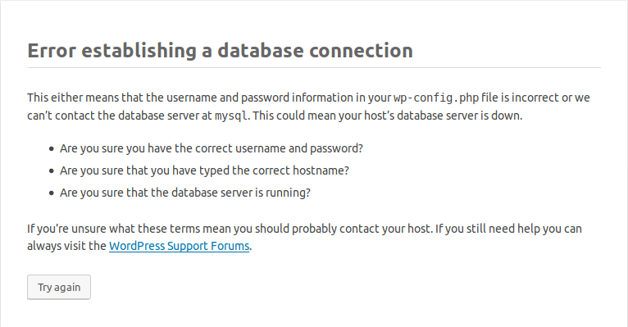
WordPress cannot connect!??

Slide 23
WordPress cannot connect!??
Of course – the WordPress container cannot the MySQL container!
We’ll need to set up our containers to live on the same network
Let’s create a new network
docker network create wordpress
Let’s dissect
network - umbrella command to manage networks
create – operation aka create a new network
wordpress – the name of our network

Slide 24
WordPress cannot connect!??
Let’s modify our container instance commands
docker run --name mysql --net wordpress -e MYSQL_ROOT_PASSWORD=albert -d mysql:5.6
docker run --name wordpress-80 --net wordpress -d -p 80:80 wordpress
docker run --name wordpress-6969 -d -p 6969:80 wordpress
Dissecting:
--net wordpress – the container instance should be part of the wordpress network

Slide 25
Demo time!

Slide 26
Docker networking
Embedded DNS
DNS resolve by
--name=mysql
--network-alias=mysql-database
https://docs.docker.com/v17.09/engine/userguide/networking/configure-dns/

Slide 27
OMG

Slide 28
GREAT NEWS!

Slide 29
MYSQL GOT A VERSION BUMP TO 5.7!

Slide 30
Upgrading to a new version
Let’s remove the old version and install our latest version.
docker ps
docker container rm <id>
docker run --name mysql --net wordpress -e MYSQL_ROOT_PASSWORD=albert -d mysql:5.7

Slide 31
Erm..my data?
How are we going to migrate our old data to the new container?
Since we did not specify, deleting the container will remove all bound information as well.
Keep in mind that a docker image is just a set of read-only layers
When data is written, docker does a copy-on-write operation and create a top read-write layer.
Once the container is deleted, the top layer is F’d.
Let’s set up some persistence!

Slide 32
Docker volumes
Docker volumes are persistent storage that are stored on the host by managed by docker.
Allows you to
Push data to a container
Pull data from a container
Share data between containers
Let’s volumize (??) our mysql container!

Slide 33
Docker volumes
Let’s create a volume
docker volume create wordpress
We can also get the available volumes
docker volumes ls
And obviously delete
docker volumes rm wordpress

Slide 34
Docker volumes
Let’s bind it to our mysql instance
docker ps
docker container rm <id>
docker run --name mysql --net wordpress -e MYSQL_ROOT_PASSWORD=albert -d mysql:5.7 --mount source=wordpress,target=/var/lib/mysql
Let’s dissect
--mount
source=wordpress – the name of the volume to mount
Target=/var/lib/mysql – where the mount should be mounted. That folder is where mysql stores the database.

Slide 35
Other types of persistence
Bind Mounts
Mapping folder(s) from the host path to the container.
Can be modified from the container itself or from the host.
Excellent if you want to instantly shift files from host to container, such as developing some website on your machine and hosting it on a docker container
Tmpfs
In memory storage
Will never be written to the FS

Slide 36
Demo time!

Slide 37
OMG

Slide 38
GREAT NEWS!

Slide 39
MariaDB is the hipster version of MySQL!

Slide 40
How easy is it to switch?
We know WordPress natively supports both MySQL and MariaDB; but are the volumes compatible? Let’s see!
Configurations are all the same; just change in the image name is all we need
sudo docker run --name mysql --net wordpress -e MYSQL_ROOT_PASSWORD=albert --mount source=wordpress,target=/var/lib/mysql -d mariadb

Slide 41
Demo time!

Slide 42
Those are a LOT of commands to execute..
What commands do we need to execute to deploy a WordPress application?
Creation of network - docker network create wordpress
Creation of volume – docker volume create wordpress
Db server - sudo docker run --name mysql --net wordpress -e MYSQL_ROOT_PASSWORD=albert --mount source=wordpress,target=/var/lib/mysql -d mariadb
WordPress - docker run --name wordpress-6969 -d -p 6969:80 wordpress

Slide 43
Those are a LOT of commands to execute..
What if we can do it at one go, with a configuration file?
We (obviously) can (what would be the point of these set of slides?)
Docker-Compose

Slide 44
Docker-Compose
Compose is a tool for defining and running multi-container Docker applications.
With Compose, you use a YAML file to configure your application’s services. Then, with a single command, you create and start all the services from your configuration.

Slide 45
Docker-Compose
Typically, 2 / 3 steps needed
Define your app’s environment with a Dockerfile so it can be reproduced anywhere. In our case, this is not needed since we’re using ready-made images
Define the services that make up your app in docker-compose.yml so they can be run together in an isolated environment.
Run docker-compose up and Compose starts and runs your entire app.

Slide 46
Our Docker-Compose to deploy WordPress

Slide 47
Our Docker-Compose to deploy WordPress
We define a version – file version so that the runtime will know how to interpret our commands
Services – in our case –
MariaDB
WordPress
Volumes – we’re calling it DB now (yay for consistency)
Networks – we’re still calling it wordpress!

Slide 48
Demo time!

Slide 49
I want to try this out, but “qehh”
Can’t be bothered to spin up a Local VM to test this out?
Is your computer a POS?
Can you even run Hyper-V?
What if..just..what if..there is a platform to run these kind of applications on the cloud?

Slide 50
OMG

Slide 51
GREAT NEWS!

Slide 52
MICROSOFT AZURE EXISTS!

Slide 53
Deploying our solution on Microsoft Azure

Slide 54
Writing our own DotNet solution!
https://docs.docker.com/engine/examples/dotnetcore/
Used Dockerfile generated by VS
Added some junk by mistake - oops
Used (pieces of) docker-compose generated by VS
Major headaches – figuring out the URLS for URLs
https://github.com/albertherd/KSSDocker
To add bind mount!

Slide 55
Making our project work on AZ
Create new DB
Set Firewall rules

